Slide 1

How To Email Delivered Rate Confirmations for Invoicing
FOR TRUCKALOCITY AGENTS

Slide 2
This tutorial provides a step-by-step look at how to email over copies of delivered Rate Confirmations
It is important that all delivered rate confirmations are emailed over for billing in a timely fashion
The quicker your customer is billed; the quicker they pay; the quicker you get paid your commission
FOR MORE HELP CALL MICHELLE @ 623-398-6370

Slide 3
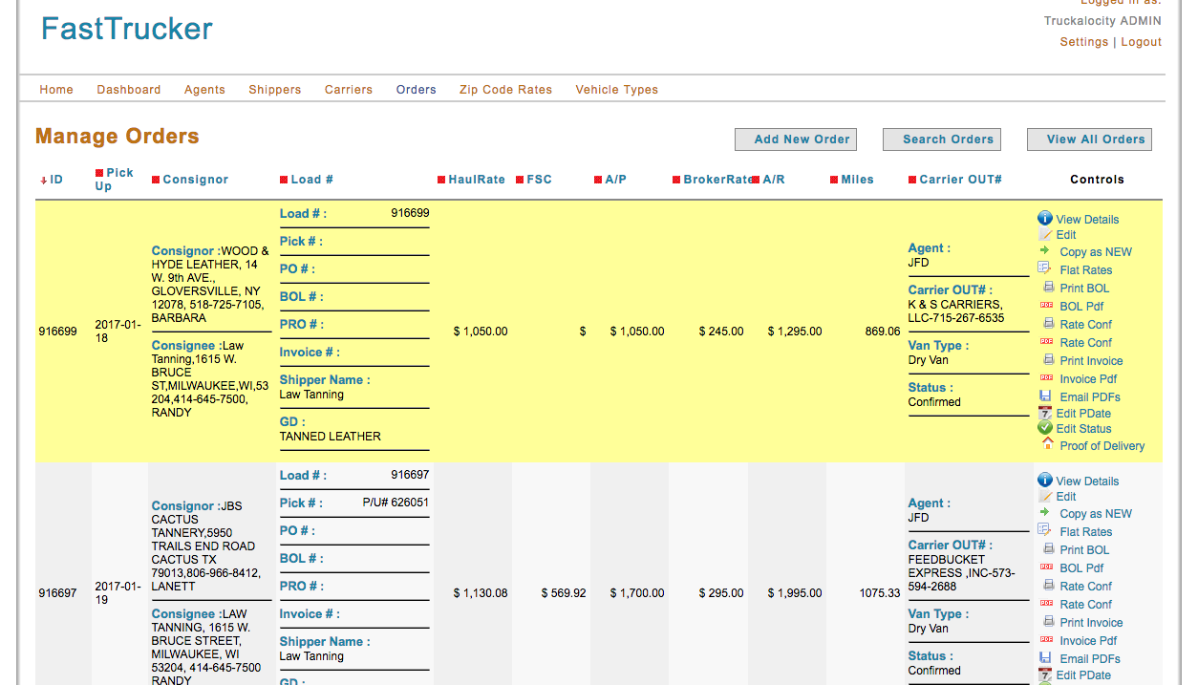
On your board in Fast Trucker – Search Orders for the load number of the load you want to email.

Slide 4
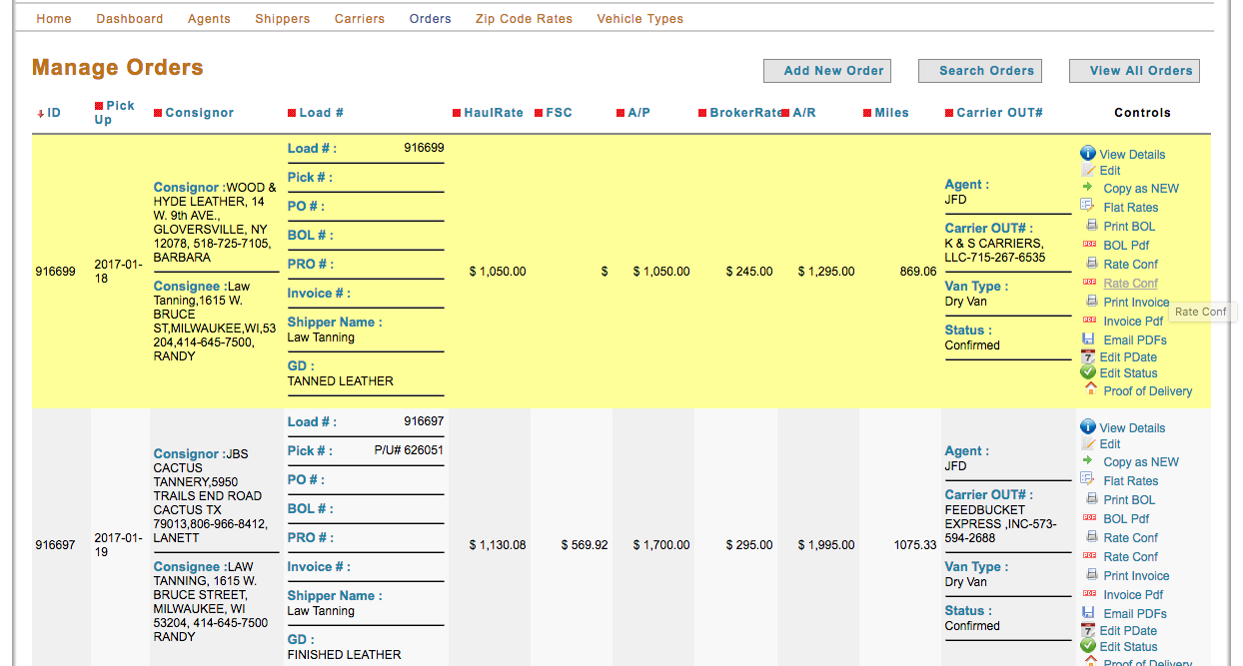
On the right hand side of the page Click On the Rate Conf. icon next to the red PDF image to download the Rate Conf. to your computer

Slide 5
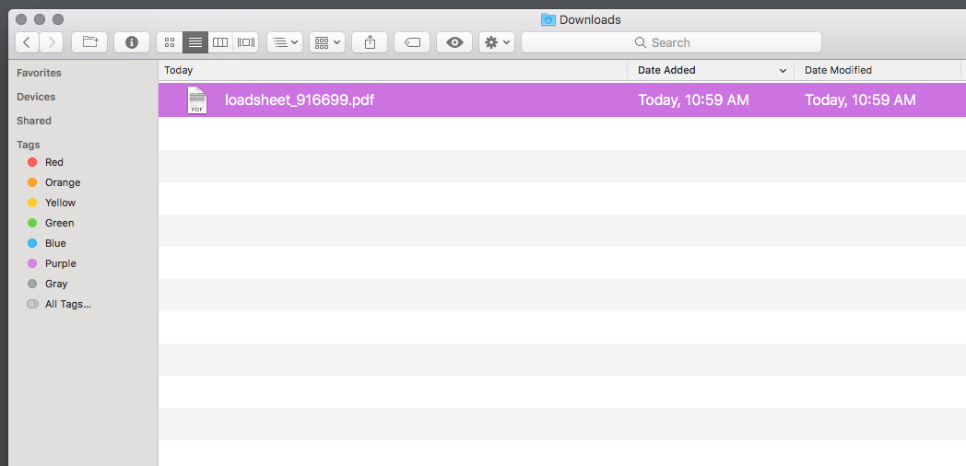
You will be able to locate the Rate Conf. files in your Downloads folder on your computer – as my example of my computer below

Slide 6
Ensure that you are able to identify the location in which your downloaded files are placed
Going into your email, open a new email and add the newly saved rate confirmation as an attachment
Email to: michelle@truckalocity.com
In the subject field type:
Your Shipper/Customer’s Name
Amount to Bill
Attach any corresponding POD’s required for billing

Slide 7
It is vital to get over delivered rate confirmations and POD’s in a timely fashion.
The faster your customer pays, the faster you get paid!
If you need additional assistance please call
623-398-6370

